Slide 1



How to use Eclipse to write and debug Groovy scripts on a live web application
  Giampiero Granatella
  giampiero.granatella@manydesigns.com

Slide 2

Our Framework: Portofino
free and open source
http://www.manydesigns.com/en/portofino/
create of a web application starting from existing databases
generate powerful, multi-level CRUD pages, and has CMS features (menu, wysiwyg html editor, portlet)
page customization using Groovy, which allows on-the-fly changes
and much more...
Let’s have a look

Slide 3
Video 1

Slide 4
Portofino benefits
Fast development
Scripting in Groovy
All your modification are immediately visible and usable
You can do anything with your browser and a text editor
But with Eclipse IDE...
Syntax Highlight
Auto completion, Import management
Refactoring
Debugging

Slide 5

OUR IDEA...
Let’s create a project that points to the web application under Tomcat.
Therefore we can make the most of Eclipse IDE and keep Groovy’s flexibility to make changes on the live system without redeploy.

Slide 6
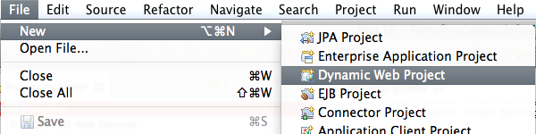
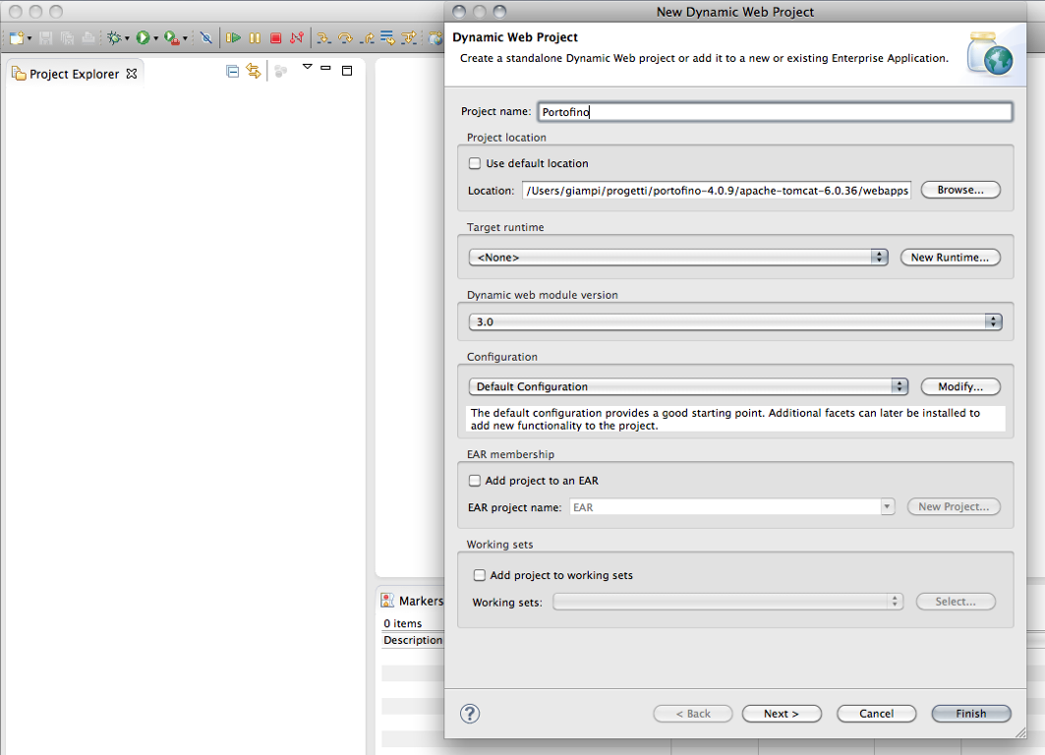
Create the Project

Slide 7
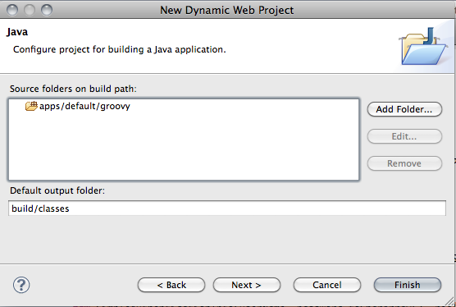
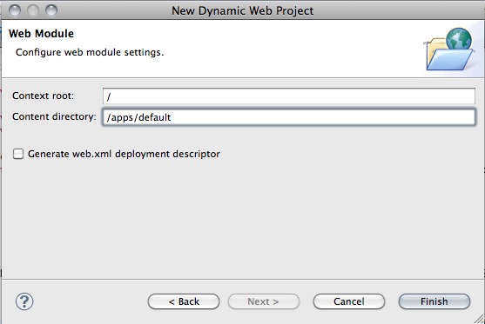
Set source folders and Context

Slide 8
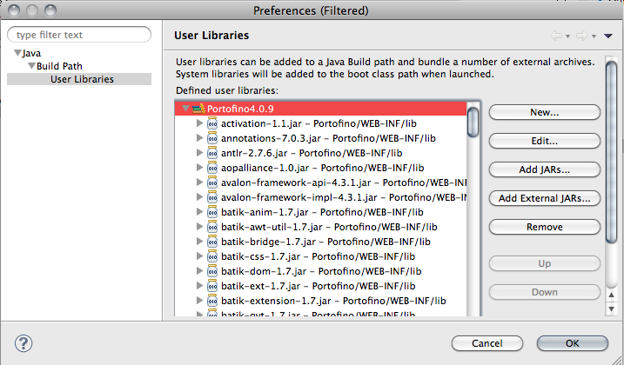
Define a user library for Portofino

Slide 9
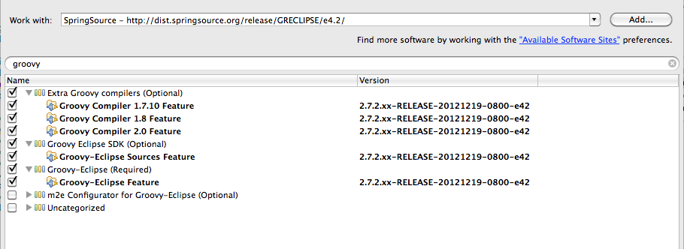
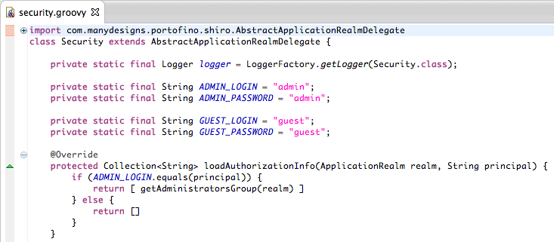
Install Groovy plug-in

Slide 10
Video 2

Slide 11
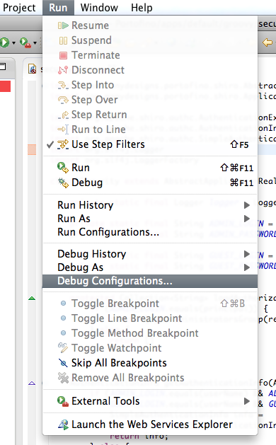
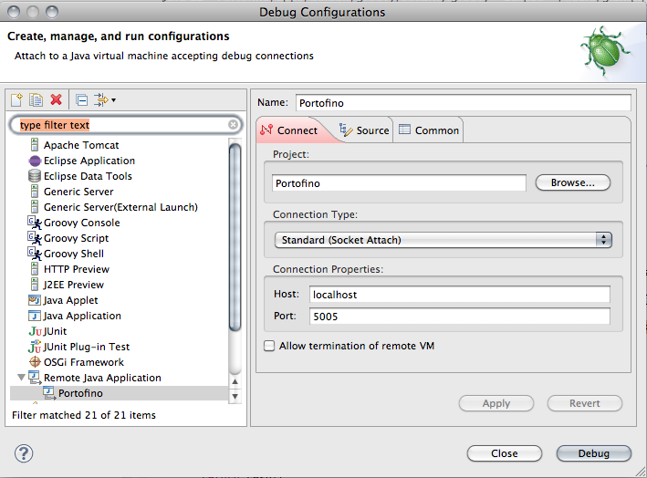
Configure Remote Debugging
Run Tomcat in debug mode
export JPDA_ADDRESS=5005export JPDA_TRANSPORT=dt_socketbin/catalina.sh jpda start

Slide 12
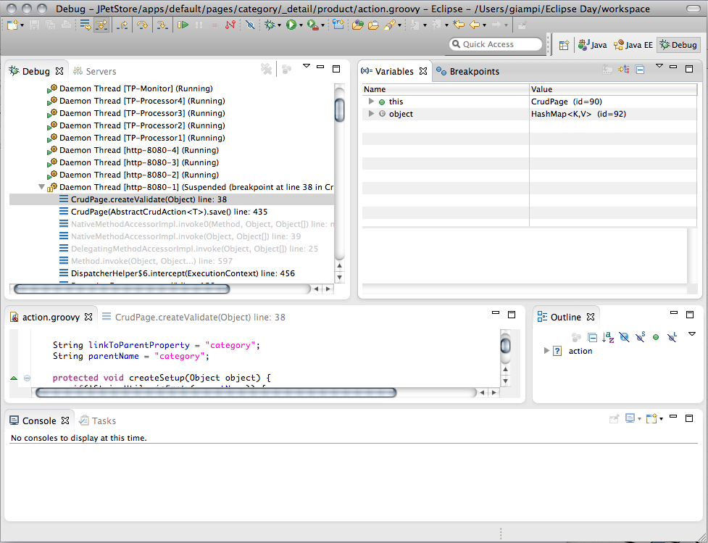

Write your Groovy script and Debug it !

